Slide 1

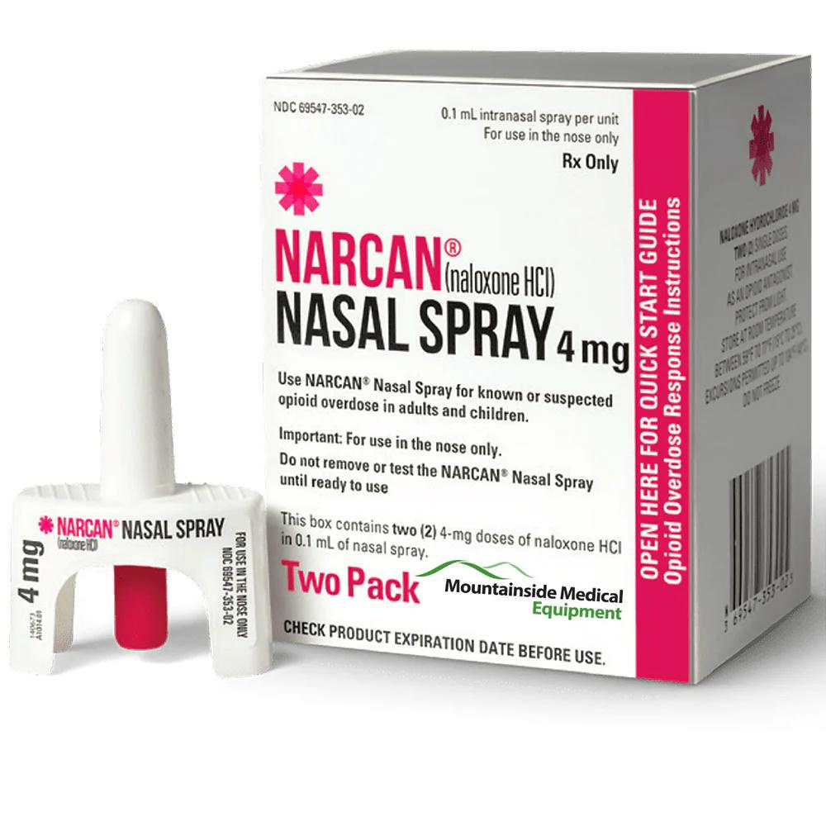

OVERDOSE PREVENTION AND RESPONSE TRAINING
Notes:
Intro Self.
We are providing overdose prevention and response training, and access to naloxone hydrochloride to reduce fatalities across the state.

Slide 2
WHAT
TO EXPECT
•The Science of Addiction
•Introduction to Overdose Prevention & Response
•Identifying Opioids
•Defining an Overdose
•Identifying Risk Factors & Overdose Prevention
•Recognizing an Overdose
•3 A’s of Overdose Response
•Resources
Notes:
Here is a look at what to expect today. These slides will be available to you following the presentation.

Slide 3

THE SCIENCE OF ADDICTION
Notes:
We will start with a short video on the science of addiction to help set the stage for today's training.

Slide 4
WHAT IS NALOXONE HYDROCHORIDE (HCL)/NARCAN®?
Notes:
Have you heard of Naloxone hydrochloride/Narcan? What is it?
Wait for answers.

Slide 5
INTRODUCTION TO OVERDOSE PREVENTION & RESPONSE
i. Naloxone hydrochloride (Narcan®️) is a medication that reverses an opioid overdose
ii. Works on opioids, including fentanyl
iii. Naloxone allows bystanders to prevent fatal overdoses
Notes:
Have you heard of Naloxone hydrochloride/Narcan? What is it?
Wait for answers.
i. Naloxone hydrochloride (Narcan®️) is a simple and safe treatment that acts to reverse an opioid overdose
ii. It works on any, all, and only opioids which includes fentanyl
iii. Everyone should know what naloxone is. Having naloxone available allows bystanders to help save lives by preventing a fatal overdose

Slide 6
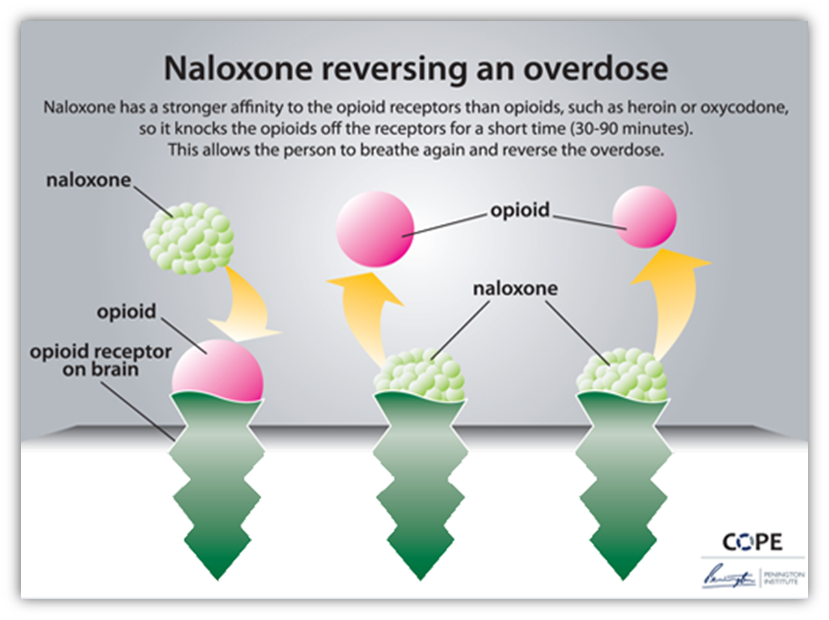
Notes:
Explain how naloxone reverses an overdose and how once it wears off the person can fall back into overdose

Slide 7
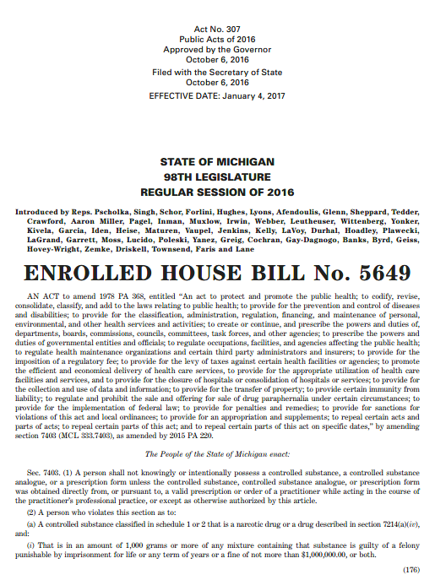
GOOD SAMARITAN LAW
The Good Samaritan Law protects the individual seeking emergency medical services and the person receiving medical attention from drug possession charges in certain circumstances.
Notes:
Read Good Samaritan Law

Slide 8
SUMMARY OF MICHIGAN LEGAL AMENDMENTS REGARDING NALOXONE
● Naloxone can be prescribed to an individual or an organization to distribute or administer it to another person. (2014 PA 311)
● Individuals who prescribe, dispense and administer naloxone are protected from civil and criminal liability for injuries or death related to those actions. (2014 PA 313,314)
● Public schools are allowed to possess and administer naloxone if adequate policy and procedure are in place (2016 PA 384,385)
● Public schools are protected from civil and criminal liability related to the administration of naloxone (2019 PA 38)
● Michigan’s Chief Medical Officer can issue a standing order for naloxone. Under this order, anyone in the state can obtain naloxone through a participating pharmacy. (2016 PA 383) List of participating pharmacies: www.michigan.gov/opioids
● Government agencies and employees (including law enforcement) are allowed to possess, purchase, and dispense naloxone (2019 PA 39)
● Government agencies and employees are protected from criminal and civil liabilities for injury or death resulting from naloxone administration or from failure to administer naloxone. (2019 PA 39, 2020 PA 321)
Notes:
Point out the summary of MI legal amendments regarding naloxone (don't read slide)

Slide 9
WHAT MEDICATIONS OR SUBSTANCES PEOPLE MIGHT OVERDOSE ON?
Notes:
Now that we have laid out some definitions, let’s talk about what are some common substances and medications that cause an overdose.
1. Question for the Group: Who can tell us what commonly used medications or substances people might overdose on?
A. Write participant responses on the whiteboard - Ask questions as needed to encourage responses
2. Question for the Group: Which of these medications or substances written are considered opioids?
A. Circle the all opioids on the whiteboard

Slide 10
OPIOIDS
NON-OPIOIDS
Oxycodone
Oxymorphone
Hydrocodone
Hydromorphone
Fentanyl
Morphine
Codeine
Methadone
Tramadol
Buprenorphine
Heroin
Cocaine
Methamphetamine
Psychostimulants (Adderall®, Ritalin®, Vyvanse®, Concerta®)
Alcohol
Marijuana
Benzodiazepines (Xanax®, Klonopin®, Ativan®)
Xylazine
Ketamine
Notes:
3. Question for the Group: Which of these opioid medications or substances can someone not get as a prescription?
A. Answer: Heroin
The point of this exercise is to highlight the fact that anyone/everyone who is using an opioid, be that illicit or prescription, is at risk of experiencing an overdose. Overdose is not limited to just illicit substances. In addition, naloxone hydrochloride is effective on any, all, and only opioid medications and/substances which are highlighted throughout this activity.

Slide 11
DEFINING AN OVERDOSE
An overdose is when someone takes too much of a medication or substance that it starts to overwhelm the body causing it to shut down.
Notes:
What is the definition of an overdose? (Acknowledge and respond to group participant’s answers)

Slide 12

VIDEO: GRAND RAPIDS RED PROJECT NALOXONE RESCUE TRAINING FOR THE COMMUNITY

Slide 13
IDENTIFYING RISK FACTORS
& OVERDOSE PREVENTION
Notes:
Now that we have defined opioids and an overdose, we are going to discuss how to prevent an overdose by looking at risk factors.
1. We break down the overdose risk factors into four categories detailed below: Mixing, Tolerance, Quality, and Using Alone
A. Write the four main risks on the whiteboard ONE AT A TIME as you are discussing them to the group – Mixing, Tolerance, Quality, Using Alone

Slide 14

Mixing
One medication or substance can amplify the effect(s) of the other
Notes:
2. Mixing
A. Question for the Group: What medications or substances are commonly mixed? Why does mixing medications or substances together increase the risk of an overdose?
a. Stimulant/Depressant (upper/downer)
i. The stimulant is exciting the central nervous system while the depressant is slowing down the function of the respiration system. As a result, the different systems of the body are being pulled in various directions.
b. Stimulant/Stimulant (upper/upper) or Depressant/Depressant (downer/downer)
i. One medication or substance can amplify the effects of the other, increasing the risk for respiratory depression.
c. Alcohol/Stimulant or Depressant (alcohol/upper or downer)
i. Due to alcohol’s accessibility and social acceptability there is a misconception that alcohol is not a drug. Alcohol tends to be the most common substance mixed with other substances. Alcohol is a high risk depressant and follows the guidelines mentioned above.
B. Question for the Group: Would you still use the naloxone hydrochloride/Narcan®️ in a multidrug overdose?
a. Yes, naloxone hydrochloride/Narcan®️ will not cause any additional harm in an overdose situation
C. Question for the Group: How can someone reduce the risk of an accidental overdose from mixing substances or medications?
a. Stagger the doses so they don’t overlap
b. Ask questions about drug interactions to the pharmacist or prescribing physician to avoid mixing high-risk medications/substances

Slide 15
Tolerance
A period of abstinence from an opioid results in a lower tolerance
This increases the risk of an overdose if the individual introduces the same dose prior to the abstinence
Notes:
3. Tolerance
A. Question for the Group: What do you think tolerance has to do with overdose risk?
a. Tolerance varies from person to person
i. Age, size, frequency of use, history of use, etc, all impact a person’s tolerance
ii. Health conditions can also affect an individual’s tolerance, including diseases of the lungs, heart, liver, and kidneys
b. An increased tolerance to an opioid resulting in a higher dose required to elicit the same effect
c. A period of abstinence from an opioid results in a lower tolerance. If unaware of this, the individual may introduce the same dose prior to the period of abstinence.
i. Abstaining from an opioid three days or more can result in a significant decrease in tolerance
B. Question for the Group: What situations would an individual's tolerance decrease? Why would an individual abstain from using opioids?
a. Answer: Incarceration, detoxification/rehabilitation, choice, recovery, finances, transportation, difficulties refilling a prescription, lack of access to pharmacy, pharmacy hours of operation, etc.
C. Question for the Group: How can someone reduce the risk of an accidental overdose when their tolerance has diminished?
a. Answer: Reintroduce the medication and/or substance in small doses
i. Be aware of the situation, understanding that tolerance has diminished before using or taking their prescription
ii. Train and distribute naloxone hydrochloride to family/friends

Slide 16
Quality
  Prescription medications are regulated
  Illicit drugs, such as heroin and synthetic fentanyl are not regulated. The potency is undetectable to the naked eye.
Notes:
4. Quality
Prescription medications are regulated i.e. we know the dose & strength of the medication.
Illicit drugs, such as heroin and synthetic fentanyl are not regulated. The potency is undetectable to the naked eye.
A. Question for the Group: Currently, what has been dramatically affecting the quality of medications and/or substances that are not obtained through the pharmacy?
a. Answer: Fentanyl
b. Fentanyl is a synthetic opioid
c. It is approximately 50-100x more potent than morphine
d. It is undetectable to the naked eye (i.e. colorless, odorless, etc.)
i. Without sophisticated laboratory equipment, the amount of fentanyl can not be determined in a medication and/or substance
e. Fentanyl has been found in numerous medications and/or substances including: Heroin, cocaine/crack, methamphetamines, and pressed pills
f. Historically, substances would have a cutting agent that is weaker than the substance itself. Nowadays, substances have the cutting agent of fentanyl without the consumer’s knowledge.

Slide 17
Using Alone
Using alone does not put an individual at risk of an overdose, but it increases the risk of a fatal overdose, as no one is there to respond.
Notes:
5. Using Alone
A. Using alone does not necessarily put an individual at risk of an overdose. However, there would not be anyone around to respond if an individual were to experience an accidental overdose
B. Question for the Group: Why might someone use a medication and/or substance alone?
a. Answer: Isolation/shame whereby an individual does not want others to know about their substance use, stigma associated with substance use, do not want to share (eg. financial reasons, do not want to be responsible for another person, etc.), no one available, or simply taking their prescription medications alone

Slide 18
Signs & Symptoms
  Unresponsive
  Blue lips
  Blue/gray skin
  Foaming at the mouth
  Loud snoring/gurgling sounds
  Slow or not breathing
  Eyes rolled back
RECOGNIZING
AN OPIOID OVERDOSE
Notes:
Recognizing an Overdose
2. Question for the Group: What does it look like when an individual is overdosing on opioids?
B. Answer: Unresponsive, blue lips, blue/gray skin, foaming at the mouth, loud snoring/gurgling sounds (explain), slow or not breathing, eyes rolled back, etc.

Slide 19
Assess (Call 911)
Administer
Aftercare
3 A’S OF OVERDOSE RESPONSE
Notes:
3 A’s of Overdose Response
List the following on whiteboard:
Assess (Call 911)
Administer
Aftercare

Slide 20
ASSESS (CALL 911)
  Check for signs of opioid overdose
    Non-responsive to voice or touch
    Non-responsive to sternum rub
    Breathing is prolonged, irregular, or has stopped
    Lips are blue or grayish color
    Are there evident signs?
    Suspected opioid use + Unresponsive or slow/no breathing = Opioid Overdose
  Call 911
Notes:
1. A for Assess – First, assess the individual to determine if they are experiencing an overdose
A. Check for signs of opioid overdose:
a. Will not wake up or respond to your voice or light touch - Demonstrate using Prestan the Manikin
i. Explain that hitting/punching/throwing people into cold showers increases harm, takes time, and can put the individual overdosing in a more dangerous situation. Cold temperatures will decrease the respiration rate of the individual further.
b. Demonstrate the sternum rub using Prestan the Manikin
c. Breathing is prolonged, irregular, or has stopped (<8x breaths per minute)
d. Are there evident signs? (eg, medication/substances, injection paraphernalia present, witnesses, etc.)
e. Suspected Opioid Use + Unresponsive or Slow/No Breathing = Opioid Overdose
B. Get emergency medical help right away - Call 911!
C. Question for the Group: Why might someone not call 911?
a. Answer: Fear of repercussions
b. Good Samaritan Law: Protects the individual seeking emergency medical services and the person receiving medical attention from any personal amount of a substance that is on their person

Slide 21
ADMINISTER - INTRAMUSCULAR NALOXONE HYDROCHLORIDE RESCUE KIT
  Empty contents of kit - put on gloves
  Take one syringe out of sterile package
  Draw up on vial of naloxone hydrochloride (one vial equals one dose of medication)
  Insert needle into a large muscle such as the thigh, buttocks, or arm and press plunger to administer contents
  Dispose of the used syringe in sharps container
Notes:
2. A for Administer - Intramuscular Naloxone Hydrochloride Rescue Kit
A. First empty the contents of the kit: a pair of gloves, 4 syringes, naloxone hydrochloride, alcohol wipes, and face shield - Display on the table in front of Prestan for group participants to view. The black container needs to be empty to dispose of used syringes safely
a. Take vials out of the UV protecting bag and show group participants what the vials look like
B. Take one intramuscular syringe out of the sterile packaging. Select a vial of naloxone hydrochloride and explain how to remove the protective orange cap while demonstrating this action
C. Draw up one vial of naloxone hydrochloride using the intramuscular syringe provided in the rescue kit. Explain that one vial equals one dose of medication
a. Note: For demonstration purposes, please recap the syringe to prevent accidental needle sticks. However, explain that one should NEVER recap a syringe and syringe should be properly disposed
D. Insert the needle into a large muscle such as the thigh, buttocks, or arm and press the plunger to administer the contents
a. Explain it is important to insert the full needle in order to reach the muscle tissue
b. Explain that the needle can go through most if not all clothing items (with the exception of leather and winter coats)
E. Dispose of the used syringe in the black container it came in as it serves as a sharps container

Slide 22
ADMINISTER - INTRANASAL NARCAN®️ RESCUE KIT
  Lay individual on their back and clear their nostrils
  Remove the nasal spray from the box and peel back the tab to open
  Hold the device with your thumb on the bottom of the plunger and your first and middle fingers on either side of the nozzle (do not prime)
  Tilt the individual’s head back slightly
  Gently insert the nozzle entirely into one nostril
  Press the plunger firmly to give the dose of intranasal naloxone hydrochloride
  If another dose is needed, administer to the other nostril for better absorption
Notes:
4. For Intranasal Narcan®️ Rescue Kit, perform the Assess and Aftercare steps the same but change the Administer.
A. Lay the individual on their back and clear their nostrils in preparation to receive a dose of intranasal naloxone hydrochloride
B. Remove the nasal spray from the box and peel back the tab to open
C. Hold the device with your thumb on the bottom of the plunger and your first and middle fingers on either side of the nozzle
a. Note: Do not “prime” the plunger
D. Tilt the individual’s head back slightly to ensure the medication does not run out of their nose
E. Gently insert the nozzle entirely into one nostril, until your fingers on either side of the nozzle are against the bottom of the individual's nose
F. Press the plunger firmly to give the dose of intranasal naloxone hydrochloride
G. If another dose is needed, administer to the other nostril for better absorption
a. Note: Emphasize that the individual does not need to be breathing for this type of naloxone hydrochloride to be effective. The medication is absorbed through the mucous membranes in the nose and does not need to be inhaled to be distributed throughout the bloodstream.

Slide 23

ADMINISTER - INTRANASAL NARCAN®️ RESCUE KIT

Slide 24
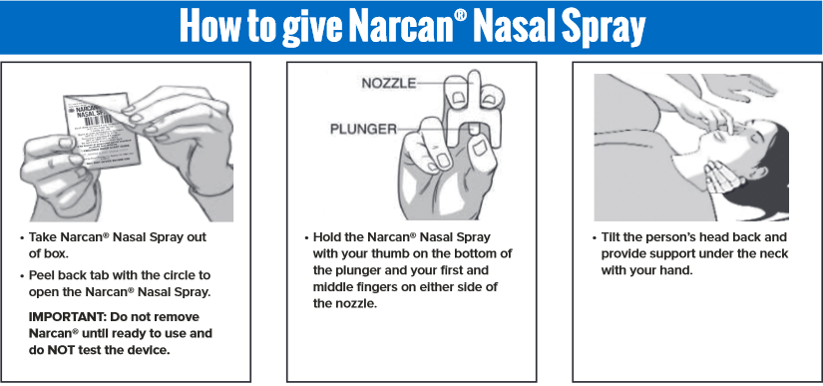
ADMINISTER - INTRANASAL NARCAN®️ RESCUE KIT
1
2
3

Slide 25
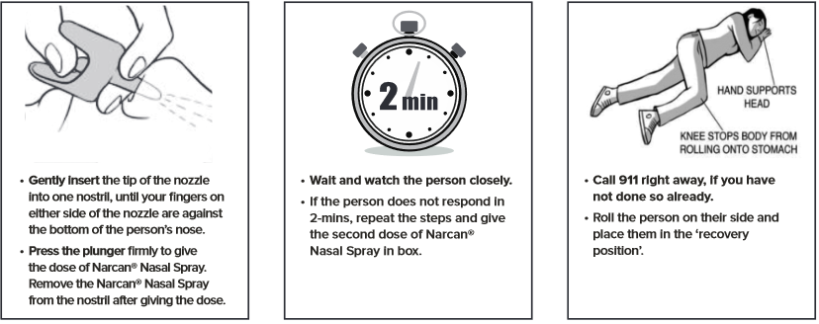
ADMINISTER - INTRANASAL NARCAN®️ RESCUE KIT
4
5
6

Slide 26
AFTERCARE
  An individual is likely to go into respiratory failure during an opioid overdose. It is vital to provide rescue breathing to supply enough oxygen to preserve life
  Naloxone hydrochloride will not have an immediate effect. The medication takes 2-3 minutes to work
    Brain damage can occur after only 3 minutes without oxygen
    Rescue breathing may be effective in reviving a person if naloxone hydrochloride is not available
  Rescue Breathing
    Lay individual on their back
    Tilt individuals head back to open the airway
Notes:
3. A for Aftercare
A. An individual is likely to go into respiratory failure during an opioid overdose. It is vital to provide rescue breathing to supply enough oxygen to preserve life.
B. Naloxone hydrochloride will not have an immediate effect on the individual who is experiencing an overdose. The medication takes 2-3 minutes to work, but during that time the individual is not getting a sufficient amount of oxygen to their system
a. Brain damage can occur after only 3 minutes without oxygen
b. Rescue breathing may be effective in reviving a person if naloxone hydrochloride is not available, or at least until emergency medical help is received
c. Providing CPR in the case of opioid overdose would only cause more harm to the individual as the individual’s respiratory system is only affected
i. CPR should not be performed in any situation without proper training and assessment
C. To provide rescue breathing:
a. First, lay the individual on their back
b. To start rescue breathing, press your palm against the person’s forehead. At the same time hook your fingers under the chin and lift it away from the spine. This action tilts the head back and opens the airway

Slide 27
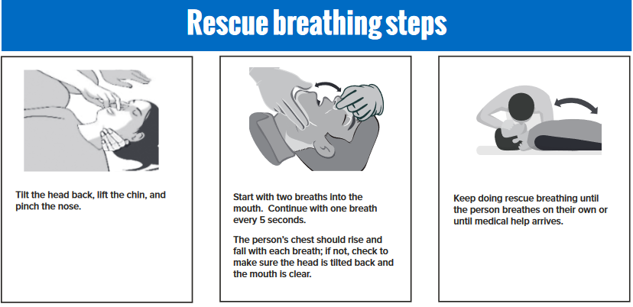
AFTERCARE - RESCUE BREATHING

Slide 28
AFTERCARE CONT.
c. Check mouth for anything that might be blocking the airway. Wearing gloves,
remove any foreign substance using a fish-hook sweep
d. Pinch nose tightly and create a seal around the individuals mouth with your
mouth ( use a face shield if available)
e. Give the individual two breaths first to make sure the air is getting into the lungs.
Then, continue rescue breathing by giving one breath every five seconds for 2-3
minutes while watching for their chest to rise
Notes:
c. Check the individual’s mouth for anything that might be blocking their airway. Put on the gloves and remove any foreign substance using a fish-hook sweep, if applicable
d. If available, take the face shield out of the yellow packaging and line it up with the individual’s face, breathing through the port/filter when required
e. Pinch the nose tightly and create a seal around the individual’s mouth with your mouth
f. Give the individual two breaths first to make sure the air is getting into the lungs. Then, continue rescue breathing by giving one breath every five seconds for 2-3 minutes while watching for their chest to rise
g. Stay calm and remember to breathe for yourself, count to five on your hand instead of out loud

Slide 29
AFTERCARE CONT.
4. Return to Administer step of the rescue response process if the individual does
not respond or improve after 2-3 minutes
a. An additional dose of naloxone hydrochloride may be administered as
needed. The individual can NOT overdose on naloxone hydrochloride
b. Continue to the Aftercare step for the rescue response process
5. Repeat the process of Administering medication and preforming Aftercare until either:
a. The individual has be come responsive; or
b. Emergency Medical Services have arrived
Notes:
D. Return to the Administer step of the rescue response process if the individual does not respond or improve after 2-3 minutes
a. If the individual does not respond to verbal or physical cues, or is not breathing normally, an additional dose of naloxone hydrochloride may be administered as needed (there are four doses per kit). The individual can NOT overdose on naloxone hydrochloride, so as many doses as needed can be administered.
b. Continue to the Aftercare step of the rescue response process
E. Repeat the process of Administering medication and performing Aftercare until either:
a. The individual has become responsive; or
b. Emergency Medical Services have arrived

Slide 30
6. BE AWARE:
a. Administering naloxone hydrochloride to an opioid-dependent individual can cause withdraw symptoms. The individual may attempt to use additional opioids to relieve these withdraw symptoms. Prevent the individual from taking any further opioids.
b. Naloxone wears off in 30-90 minutes. The individual is at risk of experiencing another overdose, even if they do not use additional opioids. Example - Heroin is a short lasting opioid (3-6 hours), methadone is a long-lasting opioid (24-48 hours), both outlast naloxone hydrochloride
Notes:
F. Be Aware: Administering naloxone hydrochloride to an opioid-dependent individual can cause withdrawal symptoms. The individual may attempt to use additional opioids to relieve these withdrawal symptoms. Prevent the individual from taking any further opioids.
G. Naloxone wears off in 30-90 minutes. Most opioids will stay in the body longer than this period. As a result, the individual is at risk of experiencing another overdose, even if they do not use additional opioids
a. For example, heroin is a short-lasting opioid (3-6 hours) whereas methadone is a long-lasting opioid (24-48 hours), both far outlast naloxone hydrochloride
H. The likelihood of an overdose recurring depends on various factors:
a. The initial amount of medication and/or substance taken and its half-life
b. Overall health status of the individual such as respiration, liver, and kidney functions
c. Additional opioid use after initial reversal
I. Stay with the individual until emergency medical services arrive
a. Place the individual in the recovery position
i. Recovery Position: Lay the individual on their left side with a bent knee to support their body and face positioned to the side

Slide 31
RESOURCES
Northern Michigan Regional Entity Access Center:
800-834-3393
Prevention, Early Intervention Services. Outpatient Services, Residential Services, Medication Assisted Treatment, Subacute Withdrawal Management, Women’s Specialty Services & Peer Recovery Support Services
NMSAS Peer Recovery Coaches: 989-732-1791, http://www.nmsasrecoverycenter.org/
Multiple Pathways: http://youpickrecovery.org/
Families Against Narcotics: https://www.familiesagainstnarcotics.org/

Slide 32
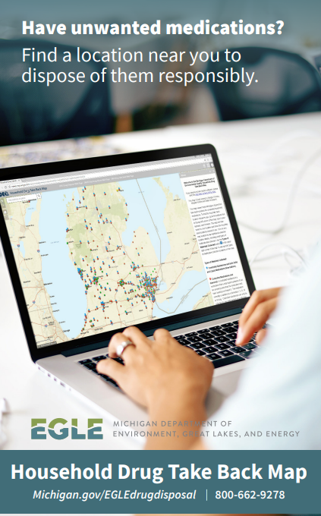
RESOURCES
Disposal of Medication: Proper disposal of unwanted household medications can help prevent substance misuse.
Visit the Michigan Department of Environmental, Great Lakes, and Energy for Map of Household Drug Take Back Locations in Michigan:
Michigan.gov/EGLEdrugdisposal |

Slide 33
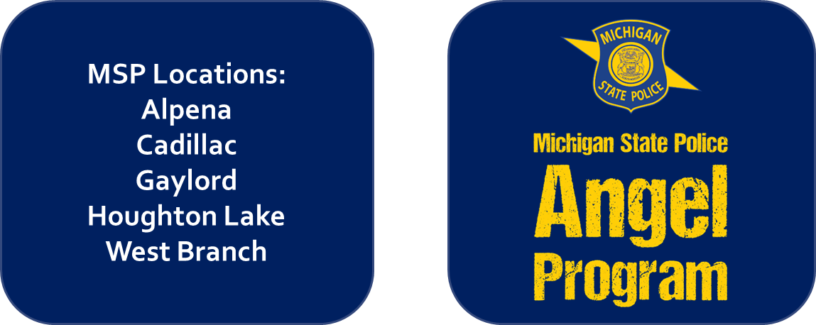
RESOURCES
MSP Angel Program: The MSP Angel Program allows an individual struggling with drug addiction to walk into a MSP post during regular business hours and ask for assistance.

Slide 34
ADDITIONAL
LOCAL RESOURCES

Slide 35
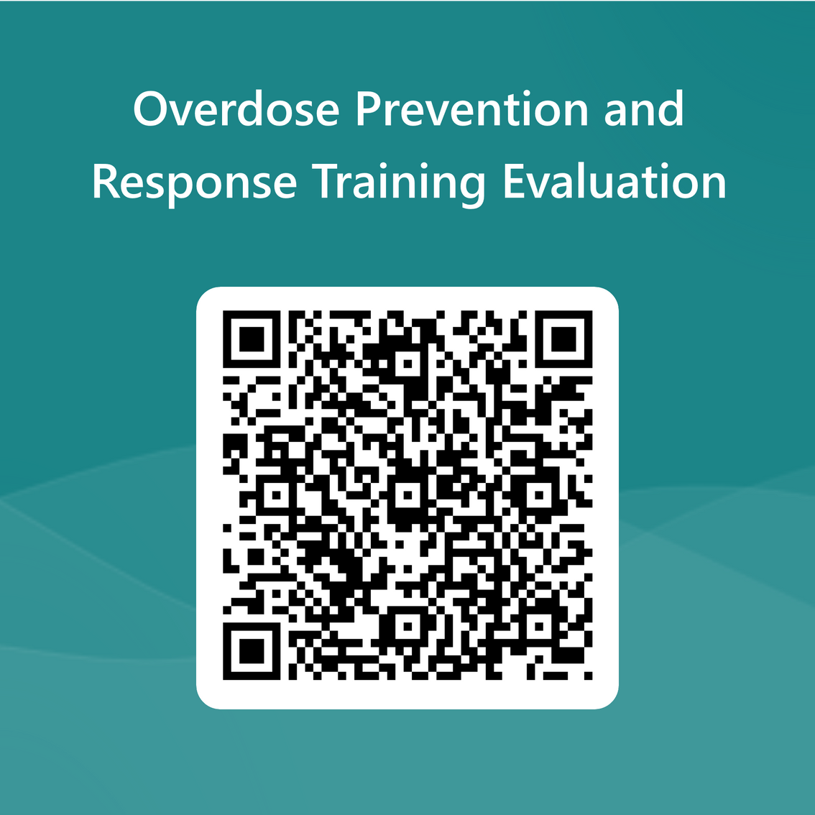
QUESTIONS?
THANK YOU!

