Slide 1
Michigan Prevention Data System for Substance Use Disorder Services
(MPDS)
To access the manual https://mpds.sudpds.com/ (Do no use www.)
Jodie Balhorn
NMRE Prevention Coordinator
Sara Sircely
NMRE Managing Director of SUD Services
Notes:
Taken from the MPDS Guidance Manual updated 2020
Located on the dashboard of the MPDS system.

Slide 2

History
This Photo by Unknown Author is licensed under CC BY-NC
Notes:
System for data collection since the Strategic Prevention Framework State Incentive Grant (SPF-SIG) in 2005
Re-wrote in 2009
Re-wrote again in 2012
In 2014, changed to PIHPs

Slide 3


What is MPDS?
Michigan Prevention Data System
THIS IS WHO TELLS US WHAT TO DO
Office of Recovery Oriented Systems of Care
OROSC
Notes:
Staff activity reporting system that collects information about the recipients of service and type of activity
Staff level Direct activity- Face to Face
Assists OROSC in collecting and reporting as required by SAMHSA

Slide 4
Activities eligible for entry
All DIRECT service activities funded in part or whole through the PIHP by Community Block Grant must be reported
Direct face–to-face (or virtual) staff activities
Not all activity performed by prevention staff will be reported in MPDS; just activities that meet requirements detailed
Time in activities as reported in MPDS does not equal the total amount of hours worked per staff person (non-direct hours should be captured elsewhere)
Notes:
Share Direct/indirect hours excel sheets examples.

Slide 5
Activities eligible for entry
  Must be quantifiable as staff time
    Captures staff time in activities, no outcome or product of the activity
    Example: time spent delivering Life Skills training is entered; time spent working with partners to adopt a smoke free policy is entered; the actual adoption of the smoke free policy would not be entered
  Must be face-to-face
    Must be face-to-face activities (can be virtual or possibly telephone)
    Example: time spent on own to research smoke free policies would not be entered
  Volunteer/intern service activities
    Services conducted by unpaid individuals would not be entered
*** May be some flexibility due to COVID-19, please check with NMRE Prevention Coordinator ***
Notes:
Jodie question- take out possibly telephone out. see next slide.

Slide 6
Activities eligible for entry
Example | Classified as an activity?
Attending a standard coalition meeting by phone or video rather than in person | Yes
Providing training via conference call | Yes
Coordinating a community planning team (a group which is not a formalized coalition) meeting by video/conference such as SKYPE | Yes
A conference call to plan an upcoming training | No
A phone call to engage a participant in future face to face activity | No
A phone call to schedule future programming | No
Pre-record an educational training segment to use for future sessions in place of face-to-face interaction | No
Attend a training or conference | No
Attend meeting out-of-region | No (unless pre-approved by RE)
Provide out-of-region presentation | No (unless pre-approved by RE)
Notes:
PAGE 3 of User Manual
NMRE qualifying examples: Group exercise
Jodie please review the State guidance for Covid restrictions.

Slide 7

Record Keeping
Sign – in sheets
Sign – out sheets for program participation
Agendas and/or meeting notes
Work calendar showing location/activity/meeting that is verified by the contact agency
Contact log (e.g. time in and out, location, contact person)identifying someone able to verify the activity
Notes:
This is proof needed for audits: If it is in the Plan, need to prove it was done.
Other Ideas: Hidden in Plain Site Trailer views tracking as training.
Contact Log is information that is put into MPDS. Page 7 Manual state someone able to verify the activity (teacher/actual referral)

Slide 8
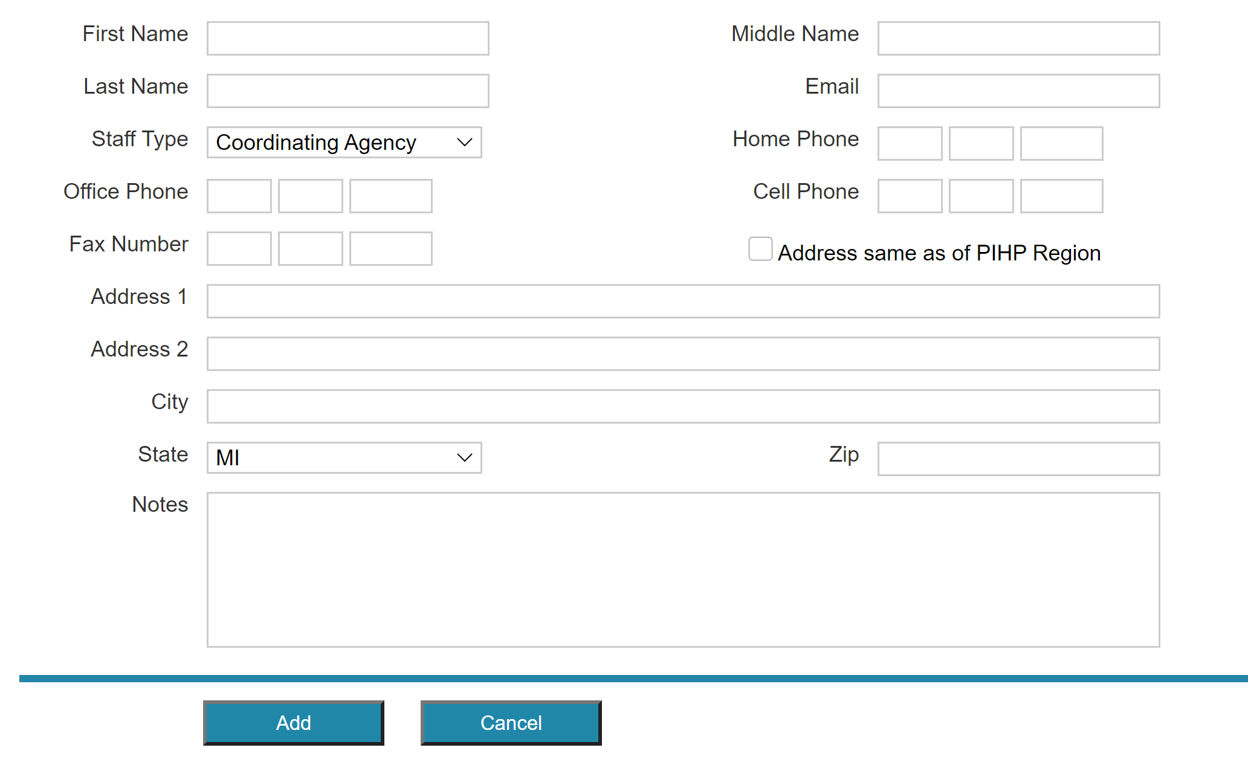
MPDS data entry
To request username and password send this information to NMRE Prevention Coordinator
Notes:
Providers
Fill out the Prevention Specialist and Supervision form-Has all this information
Please specify User or Staff
User is entering data only, not providing the service, can run reports.
Staff is providing DIRECT services, can also be a user who enters data but if staff only cannot run reports
Please specify User or Staff
Then you are able to log in to the system
NMRE ONLY
see NMRE MPDS adding user/staff for NMRE Prevention Coordinator directions
Staff Type=(NMRE Prevention Coordinator only)
Coordinating Agency is ???
Provider Agency is providers NMRE contracts for Prevention services.
Can be Staff and User. Put in user first and a box will appear if want to be staff also.

Slide 9
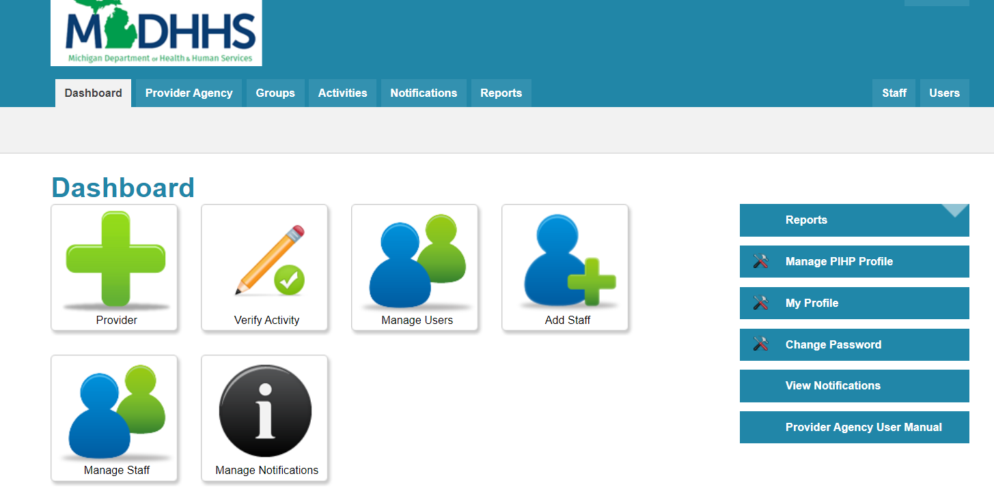
Navigation
Notes:
Dashboard (Groups, Activities, Reports) NOTICE the User Manaul
Quick Links Tab
Navigation Links (right side of dashboard)
Change your password

Slide 10

Creating groups
Dashboard>Groups
Add Group|View Groups|Find Group
Notes:
Add Group=adding a new group
View Groups=View your groups in the system
Add Group= I don’t think exists any longer

Slide 11
Group requirements
Group Name – unique, easy to work and distinguishable from other groups using same curriculum-
Synar/YTA Related – Yes or No
Gambling Prevention –Yes or No
Notes:
Go through some examples
Compare entries with Jodie example spreadsheet
Using specific data in this cell makes it easier to run reports. (LR)
For example:
Discuss C08 Coordinating Volunteers. Each county or continue to lump in under C08?? Jodie research

Slide 12
Group types
Type | Description | Examples
One-Time | Event occurs only once and is not ongoing | One-time presentation (Health Fair, Town Hall, etc.)
Ongoing – Other | Ongoing Not required or expected to be sequential participation | Coalition meetings (if in plan), parental dialogue nights, etc.
Ongoing – Sequential | Ongoing Multiple sessions in a planned sequence | Botvin’s Life Skills, Project Alert, etc.
Notes:
List out all NMRE examples

Slide 13


Program types-Names
Individual
Aimed to change an individual’s behavior
Provided to individuals or group of individuals
Example: working with parents to improve parenting skills
Aimed to change population
Not working directly with the individuals, you are trying to change
Example: creating and delivering a community norming campaign
This Photo by Unknown Author is licensed under CC BY-SA
This Photo by Unknown Author is licensed under CC BY-SA
Notes:
Program name is mandatory dropdown field specific to each PIHP. Other option is not to be used need pre-approval.
Individual Programs= Sometimes one person is court ordered/referred so would one on one-Botvins. P4L needs a min. of 3 in class.

Slide 14


Minimum, maximum activities allowed
If 8 sessions for group Min would be 1-Max would be 8
Guiding Good Choices (GGC)

Slide 15
Intervention type
Type | Description
Indicated | Targeted to individuals identified as having minimal but detectable signs or symptoms foreshadowing disorder or having biological markers indicating predisposition for disorder. Indicating this individual might have a disorder Example: Children of parents who have an SUD; youth caught with vaping paraphernalia
Selective | Risk of developing a disorder is significantly higher than average Example: Youth caught vaping for the second time
Universal – Direct | Directly providing service to a group of participants; specific population targeted based activities Example: Botvin’s Life Skills to a classroom
Universal - Indirect | Support for population-based programs and environmental strategies; broad population targeted based activities Example: Policy establishment

Slide 16
Service population- Who
Code | Category | Description | Intervention Type
04 | Children of parents with SUD | Youth and adults who are children of individuals with an SUD | Selective
05 | Delinquent/ Violent Youth | Youth who display risk factors for delinquency or violence or who have been determined to be delinquent or violent. Examples are youth declared delinquent by a State child welfare system, youth who have been arrested for juvenile delinquent behavior, youth who are chronically truant, and youth who display chronic or periodic violent behavior, including youth who display antisocial behavior (e.g., chronic fighting, hitting, using weapons). | Selective
45 | General Population | Youth and adult citizens of a state rather than a specific group within the general population. | Universal
Notes:
Who are you teaching to.
First couple from the manual and 45 is popular.
See manual for complete list of codes.

Slide 17
Service Domain
Service Domain | Description | Example
Individual | Services designed to impact an individual person’s knowledge, skills, etc. | Life skills training for youth
Family | Services designed to improve family functioning. | Program to teach parenting skills to parents.
Peer | Services designed to influence peers | Peer mentoring activities and peer-led social norming campaigns.
School/Work | Services/activities designed to change the way in which a community and its systems function. | Coalition efforts to increase prevention programming or prevention funding in the community.
Society/ Environment | Activities designed to change the environmental conditions | Coalition efforts to change public policy, activities to reduce access to substances, or media campaigns to change community attitudes and beliefs regarding substances.

Slide 18
Funding source
Funding Source | Description
SOR | State Opioid Response Grant Prevention Evidence Based Practice groups Must be approved by the NMRE
Gambling | Prevention Gambling Disorder Grant Regional gambling disorder prevention services Must be approved by the NMRE
SAPT Funded | Prevention activities to prevent substance use disorders

Slide 19
Evidence Based Practices
EBP Service Type | Description
Peer Reviewed Journal | Appeared in peer reviewed journal and was found to have positive outcomes
Youth Tobacco Act/Synar
Other Federal Agency | Program is listed by the National Institute on drug Abuse (NIDA), Office of Juvenile Justice and Delinquency Prevention (OJJDP), United States Department of Education (US DOE) or another federal agency as an effective prevention program/model
CBP Best Practice | Activities conducted through formal coalitions, task forces, community planning teams, or collaborative groups. Can be used ONLY if meets the following Project conducted using community-based process (coalitions, collaborative, taskforces) Collaborative has substance abuse specific, measurable objectives to be completed during the fiscal year Collaborative process is compatible with the five-step prevention planning process

Slide 20

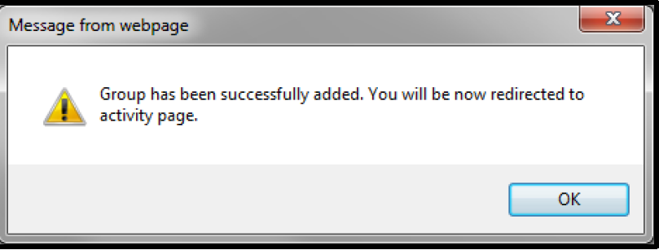
Creating activities-Two options
Option 2= If you have an existing group and an activity needs to be added go to Activities tab.
Option 1= Once you create a group and select ADD, a message will pop up.
Notes:
NOTE: First you need a program name, this is used as a general option. Your Activity is named/listed as specific EBP/ meeting.
Ensure you put the FY on both groups and activities.

Slide 21
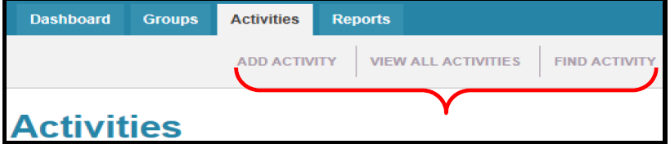
Creating activities
Here you can:
ADD Activity | View All Activities| Find Activity
Notes:
PIHP Region and Provider Agency will automatically generate.
Select the Group this activity belongs to
ACTIVITY NAME- lets discuss options
For example:
FY 21- C02- MIPHY/Other Needs Assessment Tools/Youth Pastors 08/31/2020 #52
START AND END TIME-MPDS calculates Units.
TOTAL UNITS- minimum of 15 minutes is required (JODIE) ONE UNIT=15 MinutesThis is generated by the start and end time- Jodie Found this directive in the NMRE Planning packet from 2020-Jodie change this it is wrong
60 Minutes =1 Unit
45 Minutes=.75 Units
30 Minutes= .50 Units
15 Minutes = .25 Units Example: Prescription drug presentation one on ones (LR)
TOTAL ATTENDEES Present- Don’t forget sign in/out sheets for proof
TOTAL ATTENDEES Information dissemination (N07)-speaking engagement to indirect audiences enter the estimated reach.

Slide 22
Primary strategy employed
Strategy Code | Code Description | Purpose of Activity | Examples
A01 | Supervision, guiding ATOD-free recreational event | This activity provides for participation in recreational activities that exclude ATOD and promotes healthy activities that lend themselves to the building of resiliency among youth and families. | Supervision/Coordination of: Drug Free Dances and Parties Project Graduation After School Activities ATOD – Free School Events Community Drop IN Centers ATOD free Family Activities
Notes:
See Manual for complete list
Review some of NMRE entries

Slide 23
Strategy Definitions
Positive activities that exclude alcohol an other drugs in order to meet the needs filled by alcohol/drugs with healthy Activities to discourage the use of alcohol/drugs through these activities.
Alternative
Notes:
SUD Manual page 25

Slide 24
Strategy Definitions
Ongoing networking activities and technical assistance to community groups or agencies. Neighborhood-based grassroots empowerment models using action planning and collaborative systems planning. Enhances the ability of the community to more effectively provide prevention and treatment services for alcohol, tobacco and other substance use disorders.
Activities entered MPDS include planning, interagency collaboration, coalition building, community planning teams, and networking that are done to enhance efficiency and effectiveness of services implementation Please remember that activities must be in direct contact with a recipient or community partner.
Community-Based
Notes:
SUD Manual page 25

Slide 25
Strategy Definitions
Two-way communication that is distinguished from disseminating information by the fact that it is based on an interaction between the educator and the participant. These activities generally are curriculum based or have at minimum, goals and objectives that aim to affect knowledge, concepts, principles, critical life and/or social skills, including decision making, refusal skills, and critical analysis.
Note: Only ongoing-other or ongoing-sequential groups can be counted, onetime events cannot be considered Education Strategy. Examples of methods used for this strategy include the following:
• Classroom education
• Small group education
• Parenting and family management classes
• Peer Leader and peer helper programs
• Education programs for youth groups (e.g.: anger management, life skills, safe dates, etc.)
Education
Notes:
SUD Manual pg 27

Slide 26
Strategy Definitions
Provides knowledge and increases awareness of the nature and extent of alcohol, tobacco and other drug use, abuse and addiction as well as their effects on individuals, families, and communities. It also provides knowledge and increases awareness of available prevention and treatment programs and services. It is characterized by one-way communication from the source to the audience, with limited contact between the two.
Information Dissemination
Notes:
Sud Manual pg 29

Slide 27
Strategy Definitions
Aims at identification of those who have engaged in illegal/age-inappropriate use of tobacco, alcohol or other drugs or those who have been determined to be a “high risk” for these behaviors in order to assess if these behaviors can be reversed or prevented through education. This strategy does not include any diagnostic or problem assessment activity (although individuals may be identified through screening for whom referral to a treatment assessment might be appropriate).
Problem Identification & Referral
Notes:
Sud Manual pg 30

Slide 28
Strategy Definitions
Activities working, with other individuals, to establish or change written and unwritten community standards, codes and attitudes, thereby influencing alcohol and other drug use among the general population.
Environmental
Notes:
Sud Manual pg 31
Policy change
Enforcement laws/regulations
Education
Social Norms

Slide 29
Other Entries
New Males and New Females (NOT for Universal-Indirect activities)
  Helpful Hint: If a participant did not attend session 1, but attended a subsequent session, that individual would be counted as a new participant under the attended session (e.g. participant came to session
  Est. People Reached (Only for Media/Volunteer coord/presentation to large groups)-when an official count is not possible.
Notes:
20 students for Botvins,
1 new student next session
2 didn’t show up.
Enter 21………….Discussion.
See slide 11 and breaking down classes to know this number or outcome.

Slide 30

Allowable Estimated Reach
MEDIA CAMPAIGN
    ENTER THE # OF PERSONS EXPECTED TO HEAR/SEE/READ (Get from media company)
    Entered under the activity in relation to the media campaign (one time)
    ENTER THE TIME SPENT FACE TO FACE AS AN ACTIVITY
    CAMPAIGN IN NOT A STAFF ACTIVITY-DO NOT ENTER
    Person whom you meet with face to face enter under Attendees fields.
    NOTE ~ In order to count estimated reach, you need to have a face-to-face attendee.
    E X A M P L E
When you meet with someone from the newspaper, etc. to discuss/design campaign, you would enter the time you spent with that person as direct service and identify them as new attendees and in the same entry enter the estimated reach for your media campaign.
Strategies under which this may apply:
• N02 – Supervision and technical assistance for development of Public Service Announcement PSA and other Public Information materials
Notes:
NMRE form? (LR) filled out and not entered into MPDS.
LR will send me the form.

Slide 31
Allowable Estimated reach
MEDIA INTERVIEW
    ENTER THE # OF PERSONS EXPECTED TO HEAR/SEE/READ (Get from media company)
    Press release no eligible
    NOTE ~ In order to count estimated reach, you need to have a face-to-face attendee
EXAMPLE
Strategies under which this may apply:
• N07 - Speaking engagement indirect (radio or TV interview, print media)

Slide 32

Allowable Estimated reach
PPRESENTATIONS TO LARGE GROUPS
  When you are unable to acquire an official count, enter # in estimated reach. (HEALTH FAIRS-PRESENTATIONS). Use Code N06, zero in NEW ATTENDEES and the “estimated” # in the ESTIMATED REACH field.
  If you can acquire an official count (sign up sheets) enter under NEW ATTENDEES
  N01 Distribution of materials at events, presentation, interaction with participants
  N06 Speaking Engagement (direct)- Presentation about SUD

Slide 33

Allowable Estimated reach
Volunteer Activity
  UNPAID NOT ENTERED
  If Stipend or paid, they would be entered into MPDS- see manual

Slide 34
Outcome survey
Pre-test-paper version
Post-test-paper version
Instructions
Parent Notification Form
PDS Outcome Survey Data Excel sheet-reporting
    Q1 = Oct – Dec 2020 (due Jan 31, 2021)
    Q2 = Jan – Mar 2021(due Apr 30, 2021)
    Q3 = Apr – Jun 2021 (due Jul 31, 2021)
    Q4 = Jul – Sep 2021 (due Oct 31, 2021)
    RESULTS will be shared form all PIHPS from OROSC
Notes:
At the MPDS meeting we discussed the suspension of this due to kiddos not in schools and funding.
In addition NMRE does this with the Universal populations.
Purpose – OROSC will track changes over time.
Target population- Selective/Indicated population, 7th grade and older NMRE Is mostly Universal population
Criteria- programs longer than 30 days and On-going Sequential
How- paper survey before and after programs
Submit to NMRE- Excel Sheet Quarterly
NMRE combines and sends to mpds@sudpds.com

Slide 35
Coalition
Attending a standard coalition meeting by phone or video rather than in person. Is a direct activity
Ongoing-Other is Coalition meetings
Program Type- Population- working to improve resources for parents in the community or creating and delivering community norming campaign.
Universal-Direct- Interventions involving interpersonal and ongoing/repeated contact
Universal-Indirect- Interventions involving programs and policies implemented by coalitions
Service Population 38- Coalition 12 sectors
Service Domain- Coalition efforts to increase prevention programming or prevention funding in the community
Service Domain-Society/Environment- Coalition efforts to change public policy
CBP through formal Coalitions, task forces, community planning teams or collaborative groups. Meet 3 Criteria.
1. Project is conducted using community-based process (coalition, collaborative, taskforce
2. Collaborative has substance abuse specific, measurable objectives to be completed during FY
3. Five step prevention planning: Assessment, Capacity Building, Planning, Implementation and Evaluation.
Primary Strategies- Community Based C01 (Collaborating to apply for community behavioral health grant, develop community plan for grant, meeting with local business to contribute to coalition activity)
Notes:
Proof would be agendas/meeting minutes
Page 21 Manual CBP see considered criteria.
Jodie stopped on page 21

Slide 36
Coalition-Continued
Primary Strategies- Community Based C05- Community Coalition Building and facilitating- (One on one meetings to recruit, staff chairs coalition meeting, joint planning between two or more agencies)
Primary Strategies- Community Based C06- Coalition meeting participation (Staff attend MADD, MCRUD, Interagency Councils, Multi agency task forces, local behavioral health prevention coalition, coalition subcommittees.)
Primary Strategies- Community Based C07- Coalition Technical Assistance- (Staff provide expertise to help coalition activity, assisting in developing an action plan, quality assurance and improvement guidance for coalition improvement, assist in developing a logic model)
Primary Strategies- Information Dissemination –N02- Supervision and TA for development of PSA and PI materials (Work with coalition to develop a resource guide)
Primary Strategies- Information Dissemination –N06- Speaking engagement- (Scheduled presentation on a coalition meeting, town hall, PTA etc.)
Primary Strategies Environmental – V01- TA to community norms or public policy change (EX: Coalition to implement a smoke free ordinance, implement a MJ ordinance and implement a designer drug policy)
Notes:
Page 40 for Matrix of all Codes
C08- Coordinating and monitoring volunteers/mentors (community volunteer services, coord. Volunteers for a prevention event, monitoring vol for mentoring services, neighborhood action services

Slide 37
Coalition-Continued YTA
    GROUP SCREEN Activity- Community Events- See page 41 for filling in MPDS
    Activity- YTA tobacco Coalition Meetings
    ACTIVITY SCREEN Activity- Community Events – PRIMARY STRATEGY V02 See page 42 for filling into MPDS
    Activity – YTA Tobacco Coalition Meetings- PRIMARY STRATEGY V01
Notes:
Page 40 for Matrix of all Codes

Slide 38
Jodie To Do’s
Before the provider meeting
Include in the training:
  NMRE MPDS FAQ
  Outcome Survey file
  End of Year Close out Protocol OROSC
  SAMHSA Guidelines for EBP
  MPDS SUDS User Manual for Provider Agencies Approved Nov 2016

